Slide 1
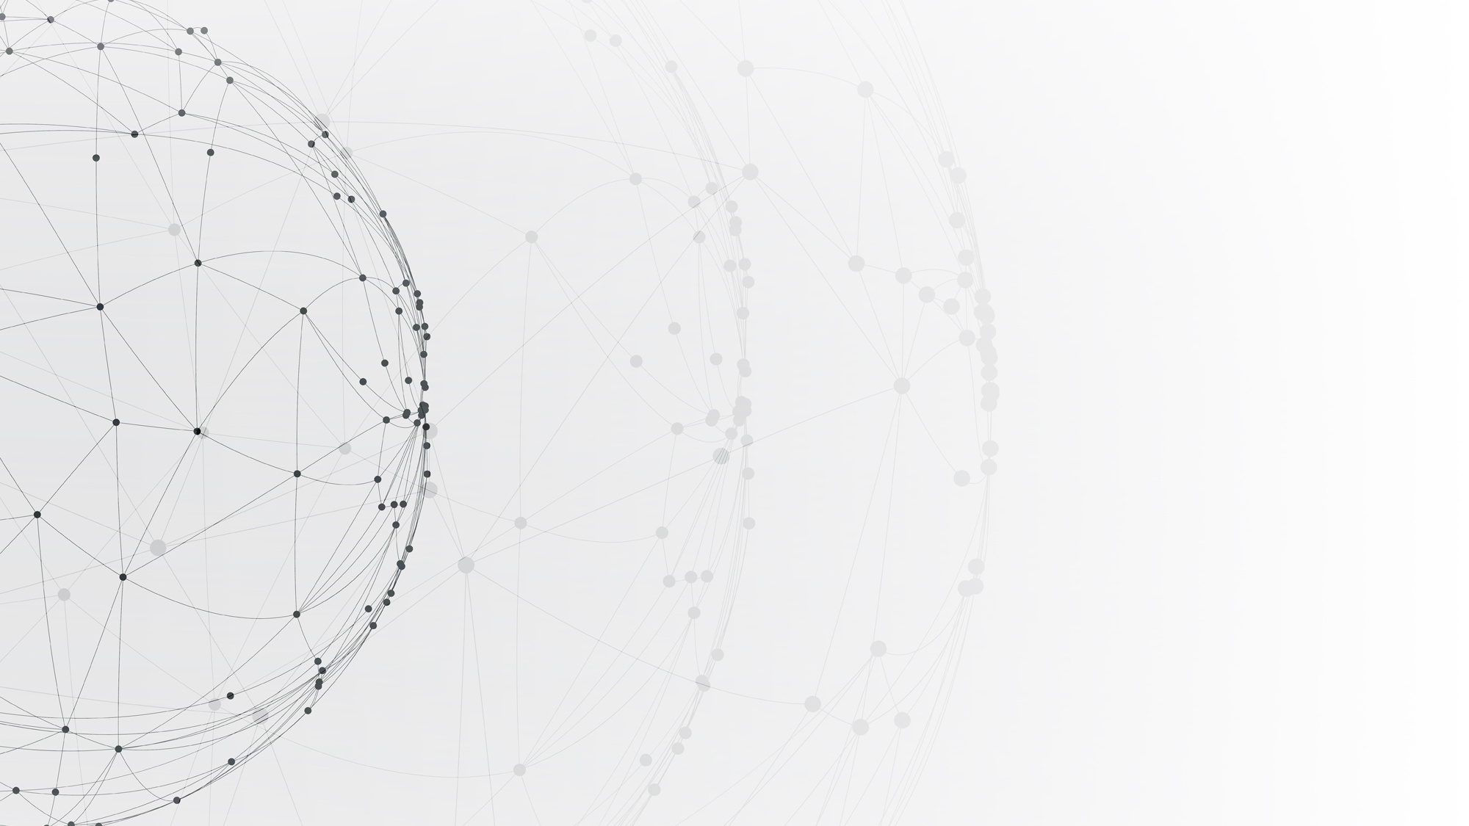

Reinforcement Learning
——Applications of AlphaGo Zero and AlphaZero
Department of Computer Science and Engineering MSc in Computer Science
By Dong, Hanwen 2023.05.08

Slide 2
01
Background
02
Implementation
CONTENTS
03
Experiments
04
Future Work

Slide 3
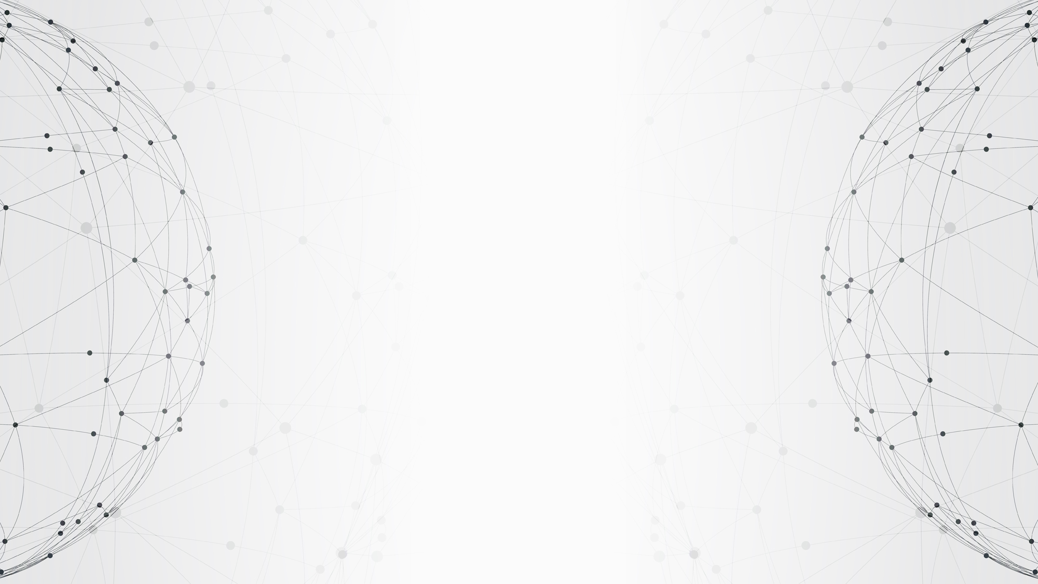
01
PART
Background

Slide 4
Background
The AlphaZero algorithm is an improvement on the AlphaGo Zero algorithm, which has demonstrated a great performance in the games, like Go, Chess, Shogi.
We attempt to implement an algorithm based on AlphaGo Zero and AlphaZero to play the game of Gobang on an 8×8-sized board, which is called Alpha Gobang.

Slide 5
Background
The Game of Gobang
Monte Carlo Tree Search

Slide 6
The Game of Gobang
Gobang, or Five in a Row, is a typical combinatorial game:
Two players, black and white. Usually, black first.
Five pieces of the same color connected in a line (horizontal, vertical or diagonal) means a player wins, otherwise it is a draw.
Freestyle Gobang has no restrictions on either player.
It has been proved by a Japanese player in 1899 that if the first player plays perfectly at each move, it must win in the end.

Slide 7
Monte Carlo Tree Search
Monte Carlo Tree Search (MCTS) is a method of sampling actions and building a search tree based on the sampled actions to find the optimal decision in a given space.
Tree structure
Search algorithm

Slide 8
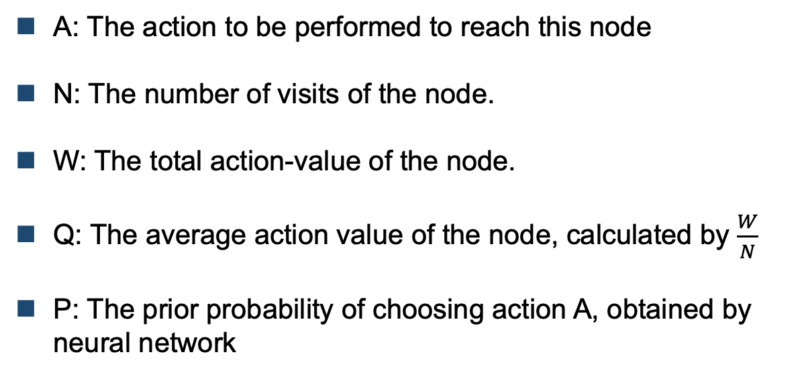
Tree Structure
Node information
A: The action to be performed to reach this node
N: The number of visits of the node.
W: The total action-value of the node.
Q: The average action value of the node, calculated by $\frac{W}{N}$
P: The prior probability of choosing action A, obtained by neural network

Slide 9
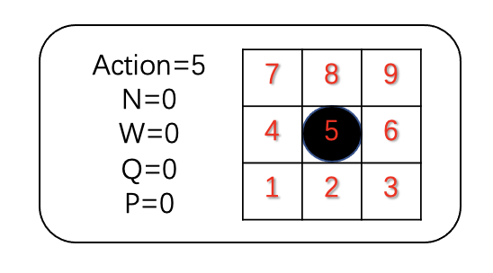
Tree Structure
The action can be represented as (𝑏, 5).
𝑁 = 0 means the number of visits to the current node is 0.
𝑊 means the total action value.
𝑄 means the mean action value.
𝑃 means the prior probability of choosing action A = 5

Slide 10
Search Algorithm
Tree search in AlphaZero:
Select: Based on a certain policy, the action is selected from the root node until it reaches leaf node.
Expand and Evaluate: Add child node to the current leaf node. The action probability and the action value are evaluated directly by policy network and value network.
Backup: The results are updated in a backward way by visiting the nodes passed in the current round of tree search. If the leaf node reaches the terminal state of the game, then the result is given by the game.

Slide 11
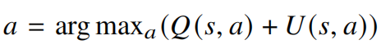
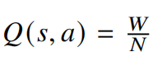
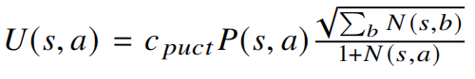
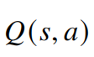
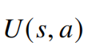
Search Algorithm
In the select stage, the action is given by
where
and
encourages to exploit action with higher action value
encourages to explore action with higher prior probability and lower visit count

Slide 12
Search Algorithm
In the expand and evaluate stage:
Policy network outputs the probability 𝑃(𝑠, 𝑎) of each action to be selected under current state.
Value network outputs the value 𝑣 of current state s
𝑃(𝑠, 𝑎) is used to calculate 𝑈(𝑠, 𝑎) described in select stage
The value 𝑣 is used to calculate 𝑊 in backup stage, where 𝑊 (𝑠, 𝑎) = 𝑊 (𝑠, 𝑎) + 𝑣.

Slide 13
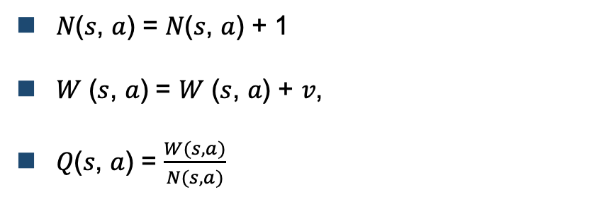
Search Algorithm
In the backup stage, all the information in each node is updated,
𝑁(𝑠, 𝑎) = 𝑁(𝑠, 𝑎) + 1
𝑊 (𝑠, 𝑎) = 𝑊 (𝑠, 𝑎) + 𝑣,
𝑄(𝑠, 𝑎) = $\frac{W(s,a)}{N(s,a)}$

Slide 14
Search Algorithm
The information stored in the node is updated either from the perspective of the black player or from the perspective of the white player.
This node is newly generated by the parent node when expanding its child nodes
The information in this node is stored from the perspective of its parent node (the black player).

Slide 15
02
PART
Implementation

Slide 16
Implementation
Differences between AlphaZero and AlphaGo Zero
In AlphaGo Zero, since the rules of Go are the same under rotation and reflection, data augmentation has been used to generate more data by rotating or flipping the game boards. AlphaZero does not augment data because the rules of games like chess and shogi are position-dependent.
AlphaGo Zero calculates and optimizes the winning probability based on win/lose outcomes. Instead, AlphaZero calculates and optimizes the expected outcomes, taking draws into consideration.

Slide 17
Implementation
Differences between AlphaZero and AlphaGo Zero
In AplhaGo Zero, self-play data are generated by the best player from the historical training. After each iteration, if the new player wins the best player by around 55%, it will replace the best player and the following self-play data will be generated by this new player. In contrast, in AlphaZero, self-play data are generated by a single neural network. It only maintains one network and generate data by using the latest parameters for this network.

Slide 18
Implementation
Implementation based on AlphaZero and AlphaGo Zero
We utilize data augmentation, like in AlphaGo Zero, since the rules of Gobang are the unchanged under rotation and reflection
We take draws into account and only maintain one single neural network to generate self-play data, like done in AlphaZero.

Slide 19
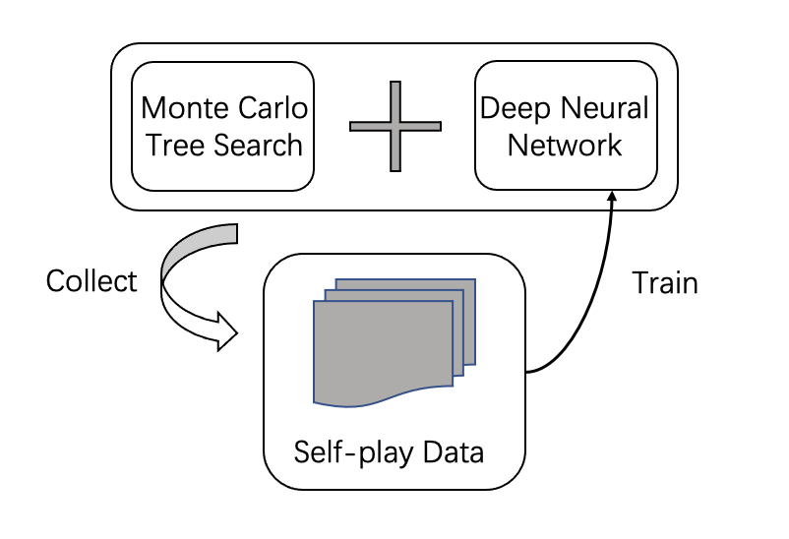
Implementation
Monte Carlo tree search combined with neural network is used to generate self-play data
The generated data is used to train the network to improve the prediction accuracy of the network.

Slide 20
Implementation
Monte Carlo Tree Search in AlphaZero
Training a Neural Network

Slide 21
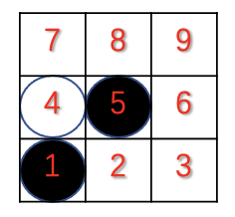
Monte Carlo Tree Search in AlphaZero
We assume that the game starts from the state shown above.
At this point, it is the white player’s turn to perform the action.

Slide 22
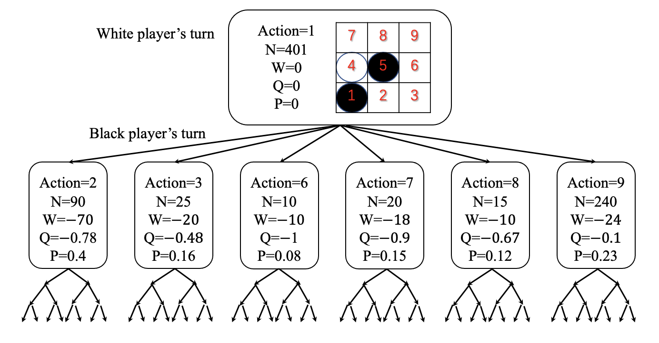
Monte Carlo Tree Search in AlphaZero
Tree structure after 400 searches

Slide 23
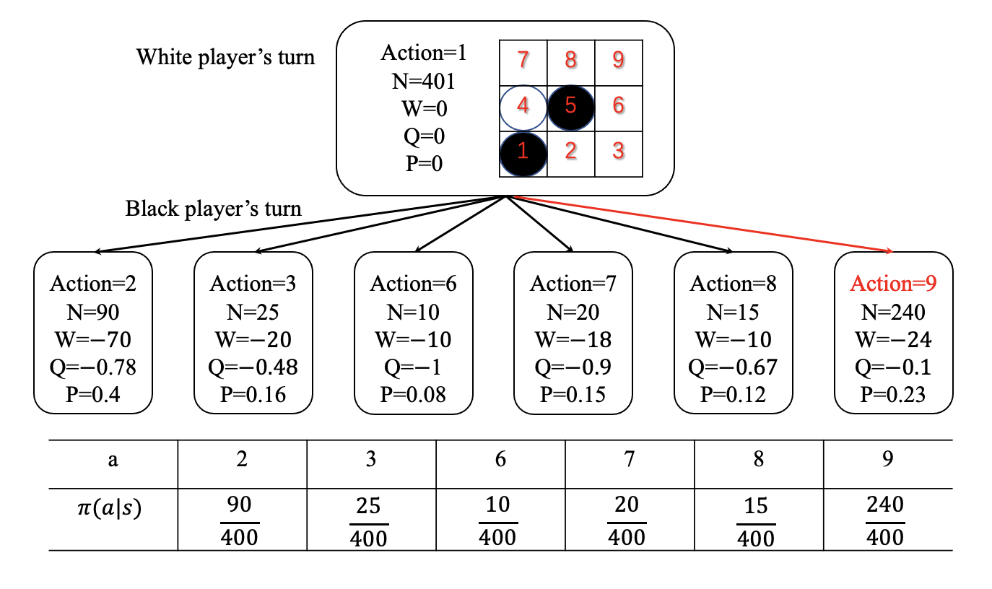
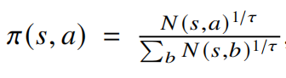
Monte Carlo Tree Search in AlphaZero
AlphaZero selects a move based on policy $π(s,a)$

Slide 24
Monte Carlo Tree Search in AlphaZero
The temperature parameter 𝜏 controls the level of exploration.
If 𝜏 = 1, the probability of selecting an action is proportional to the number of visits, which has a high level of exploration and ensures the diversity of data.
If 𝜏 → 0, action with the highest visit count is preferred.
First 30 moves of each game, 𝜏 = 1. The rest of the game, 𝜏 → 0.

Slide 25
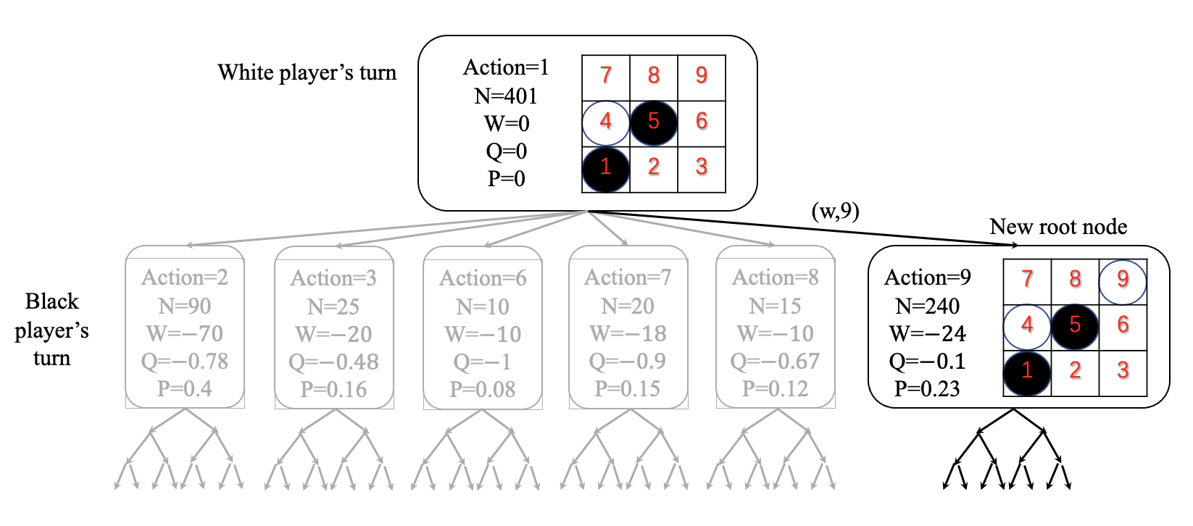
Monte Carlo Tree Search in AlphaZero
AlphaZero selects action 9
Other sibling nodes and their parent nodes will be pruned and discarded to save memory.

Slide 26
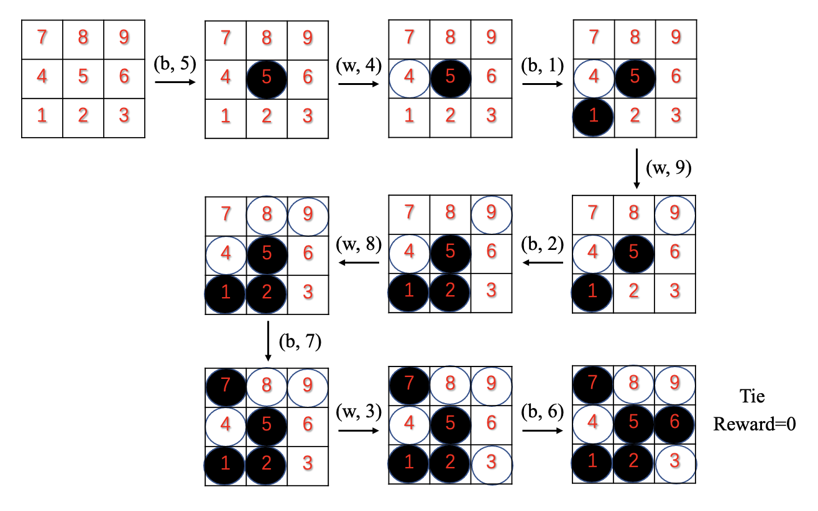
Monte Carlo Tree Search in AlphaZero

Slide 27
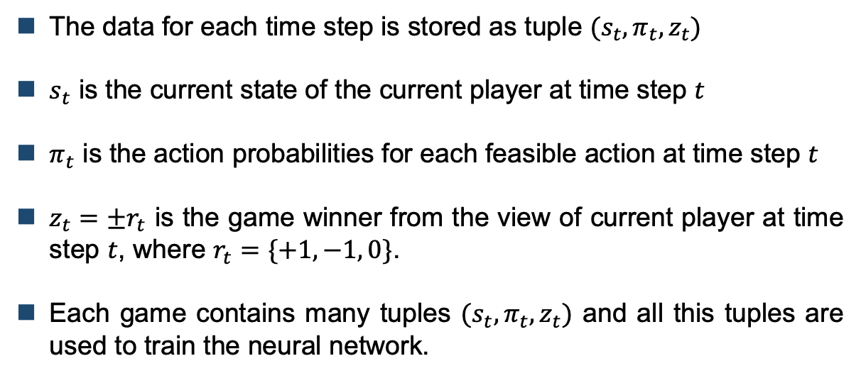
Monte Carlo Tree Search in AlphaZero
The data for each time step is stored as tuple $(s_{t},π_{t},z_{t})$
$s_{t}$ is the current state of the current player at time step $t$
$π_{t}$ is the action probabilities for each feasible action at time step $t$
$z_{t}={±r}_{t}$ is the game winner from the view of current player at time step $t$, where $r_{t}=\{+1, −1, 0\}$.
Each game contains many tuples $(s_{t},π_{t},z_{t})$ and all this tuples are used to train the neural network.

Slide 28
Implementation
Training a Neural Network

Slide 29
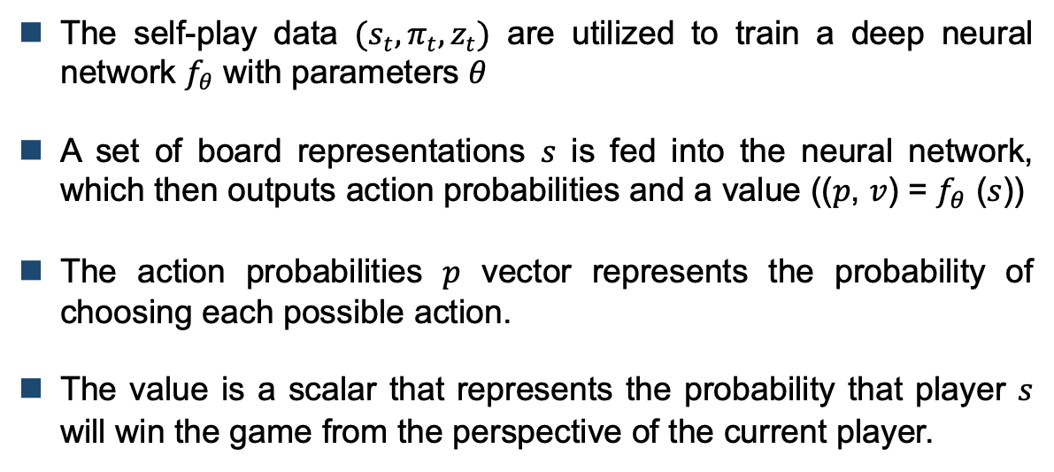
Training a Neural Network
The self-play data $(s_{t},π_{t},z_{t})$ are utilized to train a deep neural network $f_{θ}$ with parameters $θ$
A set of board representations 𝑠 is fed into the neural network, which then outputs action probabilities and a value ((𝑝, 𝑣) = $f_{θ}$ (𝑠))
The action probabilities 𝑝 vector represents the probability of choosing each possible action.
The value is a scalar that represents the probability that player 𝑠 will win the game from the perspective of the current player.

Slide 30
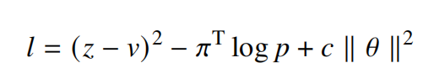
Training a Neural Network
The neural network is updated to reduce the error between the predicted value 𝑣 and the self-play winner 𝑧
As well as to maximize the similarity between the action probabilities 𝑝 constructed by neural network and search probabilities 𝜋.

Slide 31
Training a Neural Network
The goal of neural network training is to allow the network to learn from MCTS.
We may consider the process of learning better action probabilities via MCTS to be a policy improvement.
The process of using MCTS to select action and using game winner 𝑧 as sampled value can be considered as a policy evaluation.
Update the neural network to make 𝑝 and 𝑣 generated by neural network close to 𝜋 and 𝑧 generated by MCTS. The newly updated parameters are utilized in the next search to generate a stronger search policy.

Slide 32
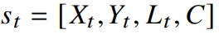
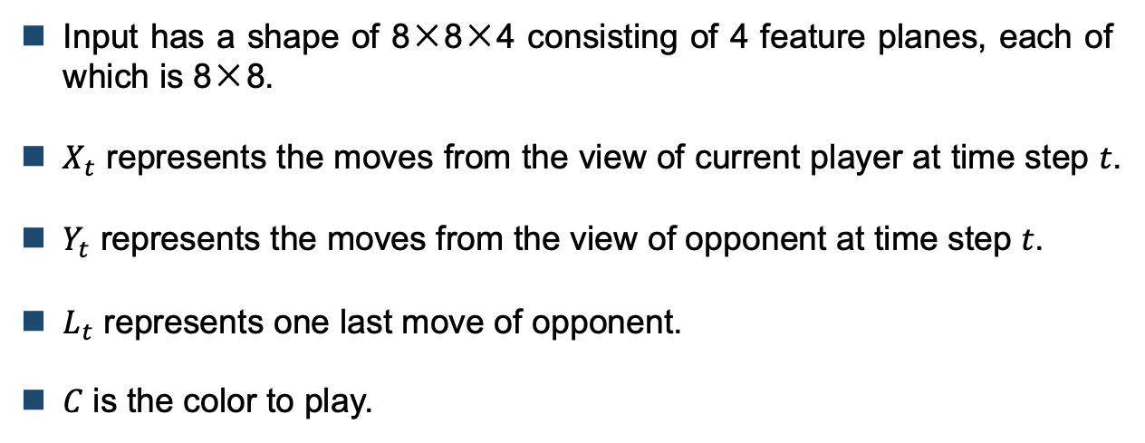
Input Features
Input has a shape of 8×8×4 consisting of 4 feature planes, each of which is 8×8.
$X_{t}$ represents the moves from the view of current player at time step 𝑡.
$Y_{t}$ represents the moves from the view of opponent at time step 𝑡.
$L_{t}$ represents one last move of opponent.
𝐶 is the color to play.

Slide 33
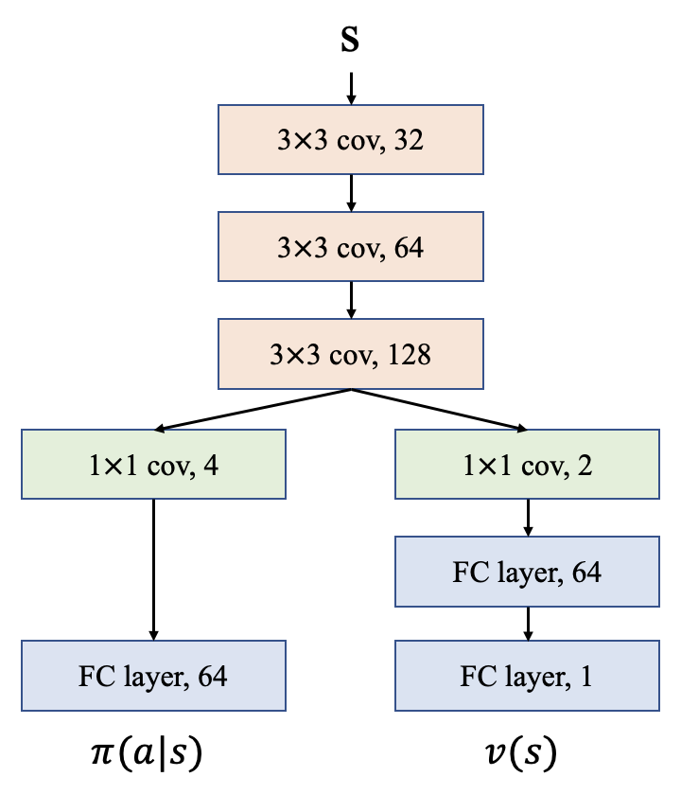
Network Structure

Slide 34
Further Optimization for the Training
Problem of data imbalance
For the freestyle Gobang, if the first player plays perfectly at each move, it must win in the end.
The consequence of this is that during the training, the number of winning games for the first player will be far more than that for the second player.

Slide 35
Further Optimization for the Training
Problem of data imbalance
The data is unbalanced, which causes an unbalanced preference that further allows the self-play to produce more winning games for the first player.
The value of prediction for the first player is close to 1, the value of prediction for the second player is close to -1.
As a result, there will be many games with lengths of only 9 or 11.
It means that the first player quickly forms five pieces in a row, but the second player forms only four pieces or stones are arranged in a messy manner.

Slide 36
Further Optimization for the Training
One thing to note is that, under the freestyle rule, we found that the advantage of the first player can not be completely eliminated during the training.
If the noise is large enough and the training is long enough, this problem can be alleviated, but it is rather time-consuming.
Our objective is to alleviate this problem more effectively and try to keep the data balanced on both sides as much as possible.

Slide 37
Further Optimization for the Training
The first approach
Keep tracking how many games the first and second players have won in the data buffer.
If the number of games won by a certain side is insufficient, whenever a winning game for this side is collected, this game is added to data buffer again.

Slide 38
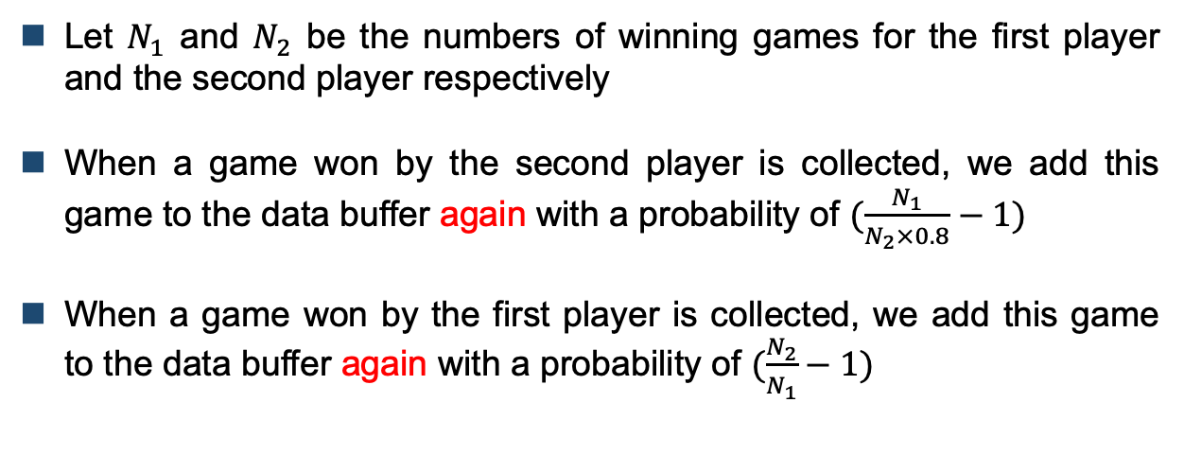
Further Optimization for the Training
Let $N_{1}$ and $N_{2}$ be the numbers of winning games for the first player and the second player respectively
When a game won by the second player is collected, we add this game to the data buffer again with a probability of $(\frac{N_{1}}{N_{2}×0.8}−1)$
When a game won by the first player is collected, we add this game to the data buffer again with a probability of $(\frac{N_{2}}{N_{1}}−1)$

Slide 39
Further Optimization for the Training
The second approach
Discard the game with short length with a certain probability
The game with a length of 9 will be discarded with a probability of 0.9; the game with a length of 20 will not be discarded.
As the length of a game increases from 9 to 20, the probability of discarding it decreases linearly.

Slide 40
Further Optimization for the Training
The third approach
Apply a training weight to each state
During the self-play training, the later state in one game appears less frequently, while the earlier state appears more frequently.
Later moves may be more associated with winning or losing.
A weight growth factor is created such that the training weight for the later state is higher than the training weight for the earlier state. States with higher weight are more likely to be sampled.

Slide 41
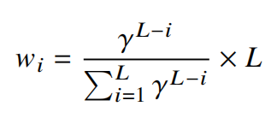
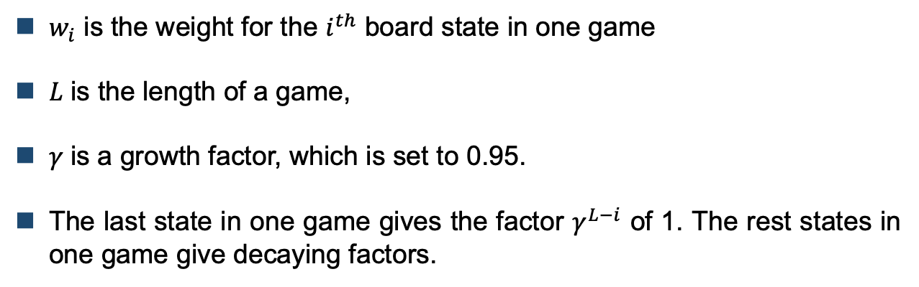
Further Optimization for the Training
$w_{i}$ is the weight for the $i^{th}$ board state in one game
𝐿 is the length of a game,
𝛾 is a growth factor, which is set to 0.95.
The last state in one game gives the factor $γ^{L−i}$ of 1. The rest states in one game give decaying factors.

Slide 42
Further Optimization for the Training
We also apply another algorithm called Algorithm A With a Reservoir (A-Res), which is proposed by Efraimidis and Spirakis in a paper “Weighted random sampling with a reservoir”
It solves the problem of weighted random sampling (WRS) without replacement.
It inputs a population V of 𝑛 weighted items and outputs a reservoir R with a WRS of size 𝑚.

Slide 43
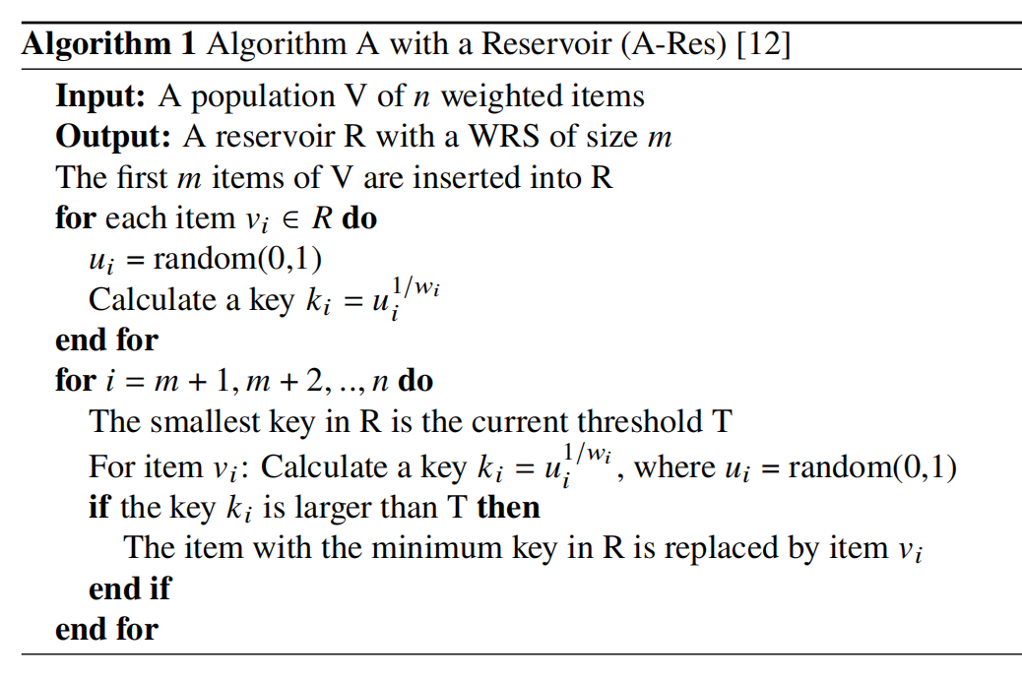
Further Optimization for the Training

Slide 44
03
PART
Experiments

Slide 45
Experiments
We implemented Alpha Gobang using Pytorch based on Python3.7
We trained the model for 3500 iterations on the board with size 8×8.
Environment: MacBook Pro (13-inch, 2020, Four Thunderbolt 3 ports), with CPU 2 GHz four-cores Intel Core i5

Slide 46
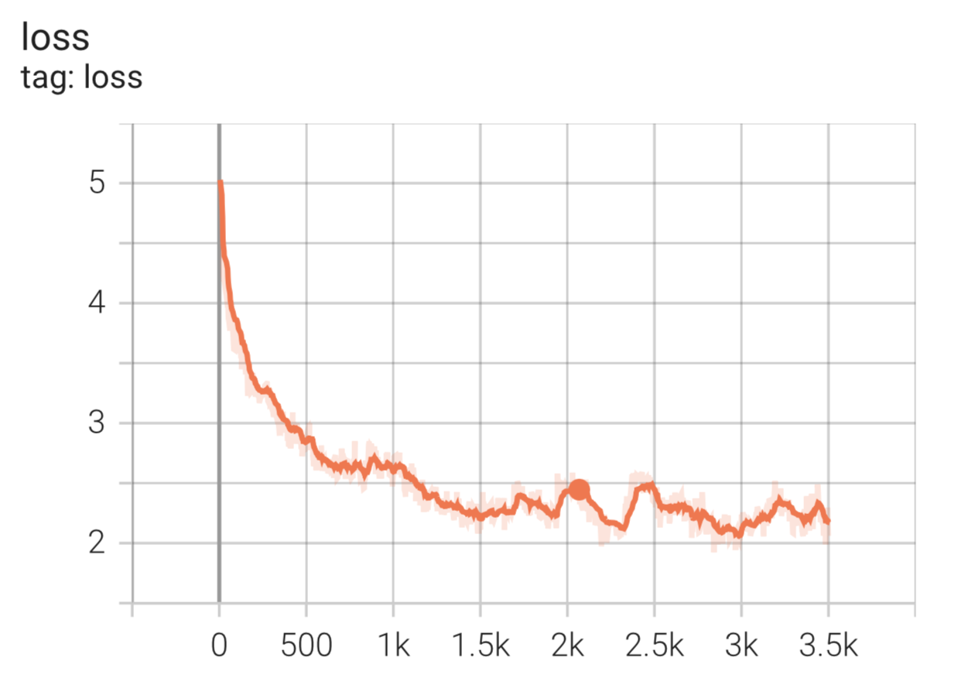
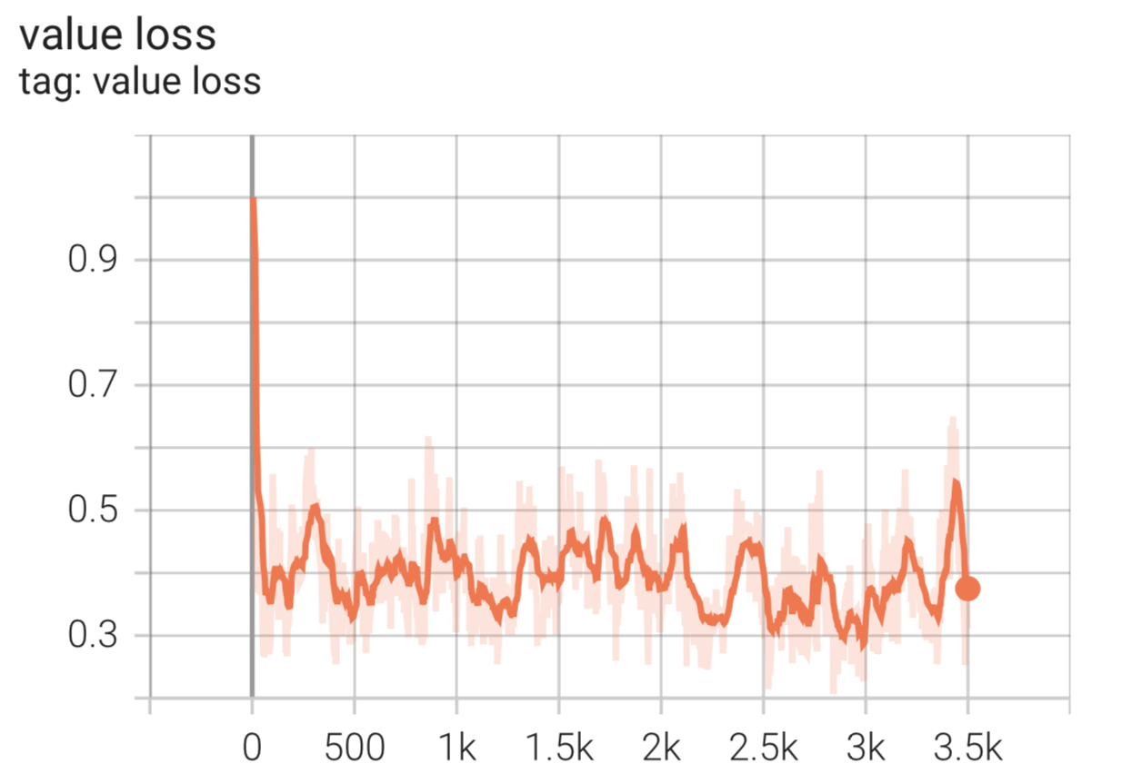
Experiments
Total loss
Value loss

Slide 47
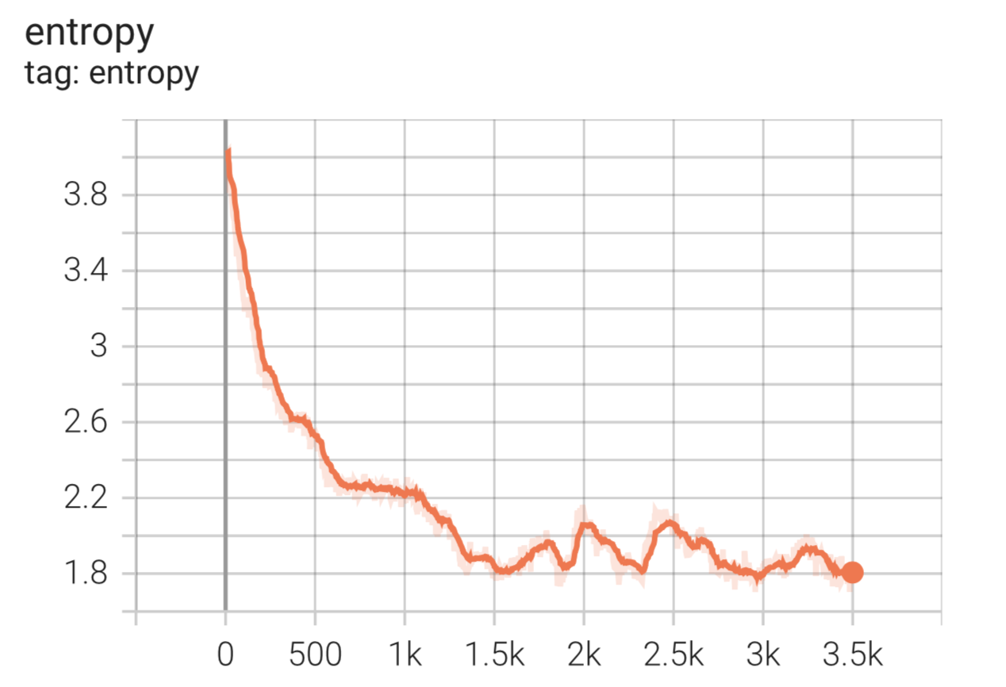
Experiments
Network output a uniform random probability at the beginning
As the training continues, the action probability is no longer uniform
Entropy of the action probability output by the policy network

Slide 48
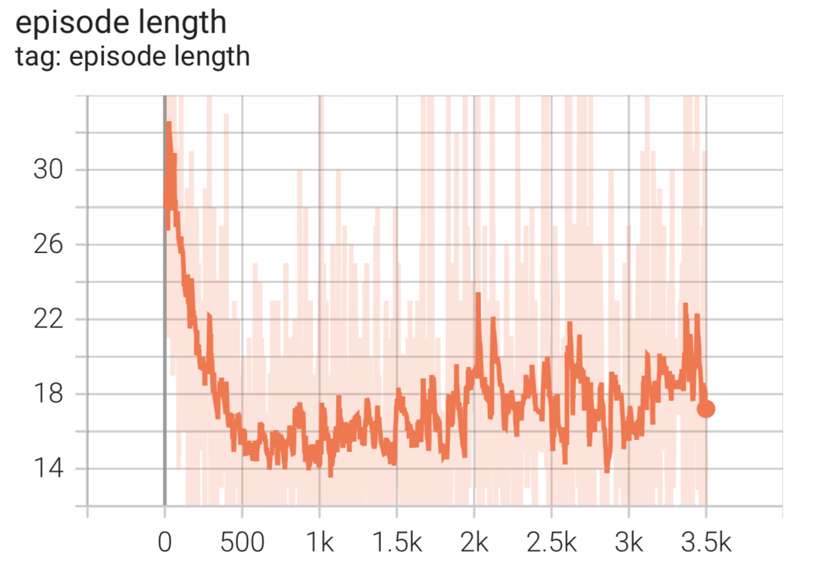
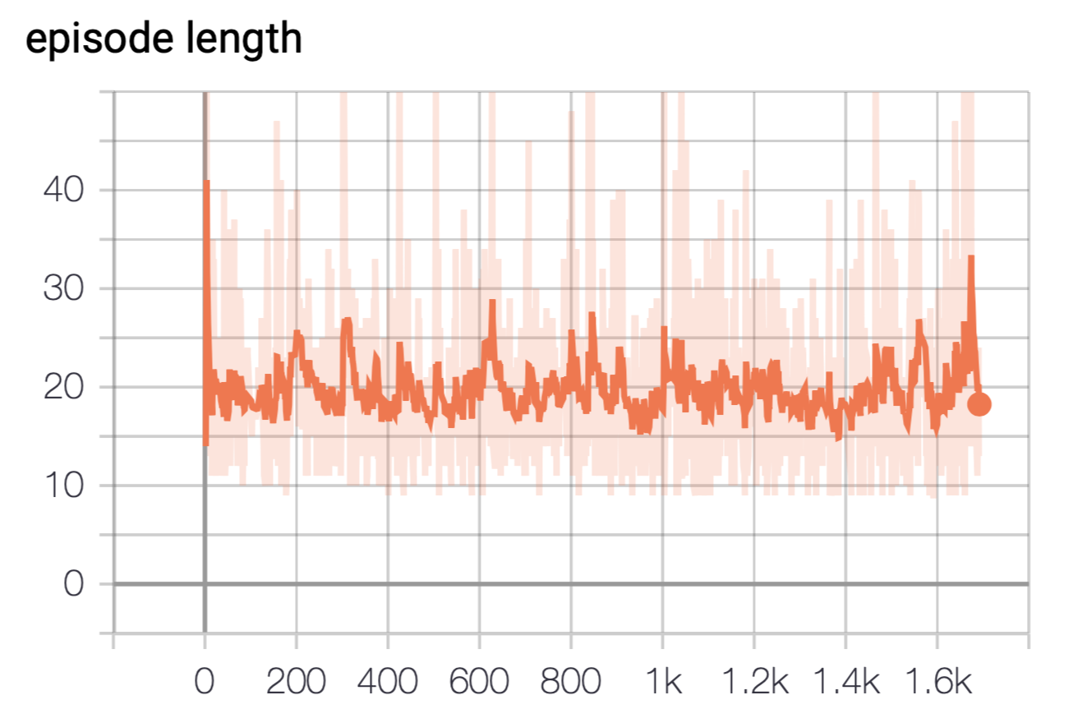
Experiments
Episode length for 3500-iterations training
Episode length after retraining 1700 iterations

Slide 49
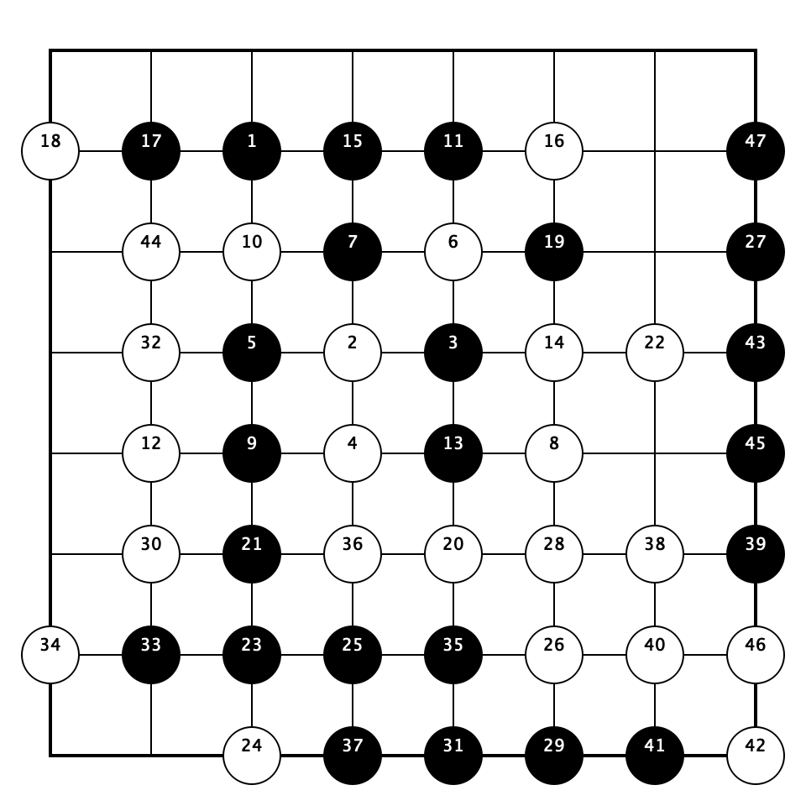
Experiments
One self-play game generated by the model trained for 5500 iterations

Slide 50
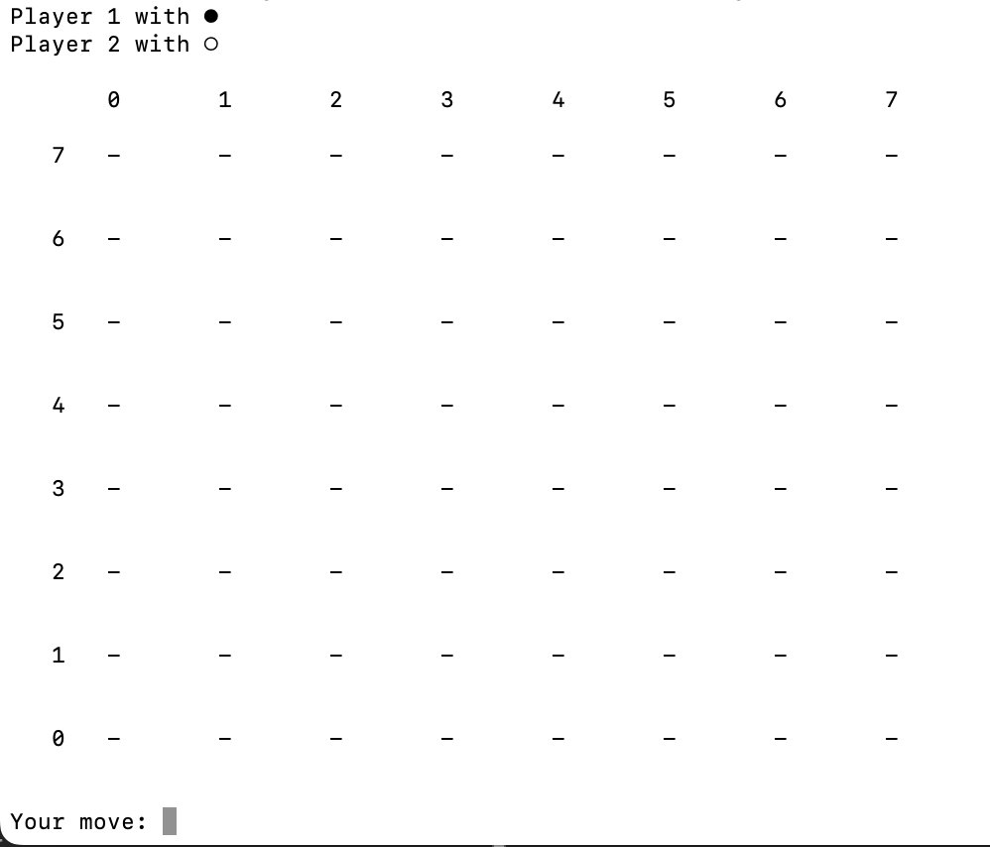
Experiments
We only need to enter the coordinate of the position
If we want to put a stone at position (4,3), we only need to enter ‘4,3’
Game interface

Slide 51
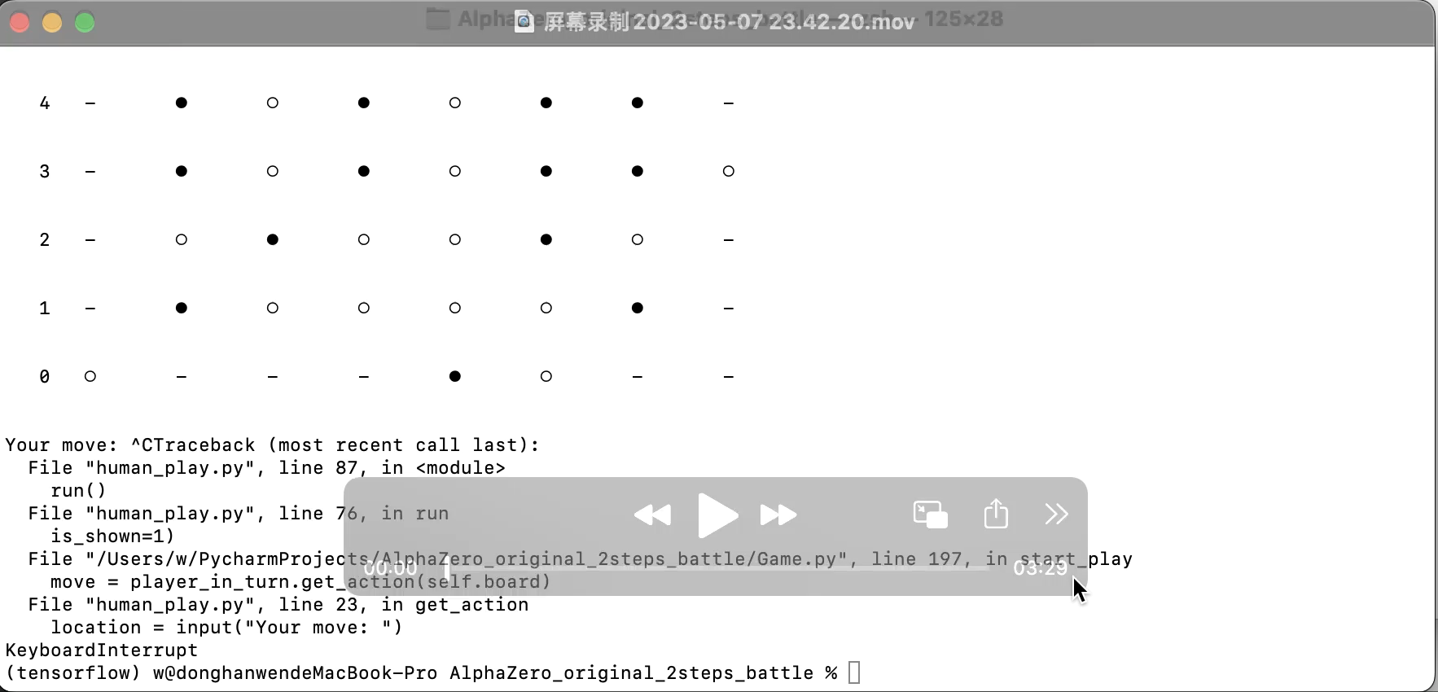
Experiments

Slide 52
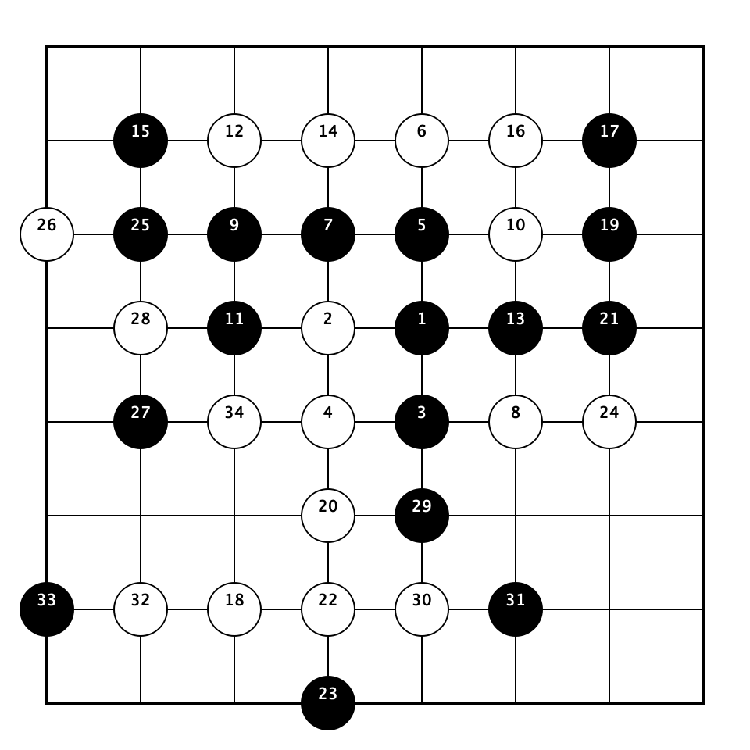
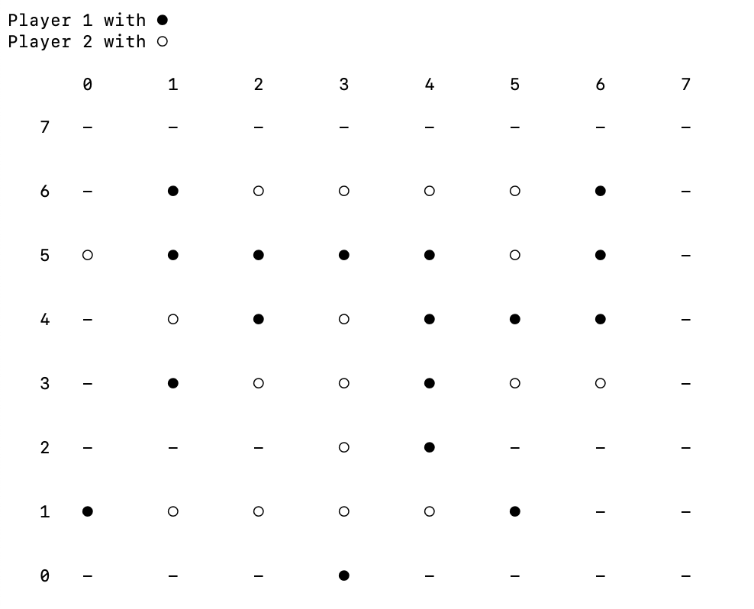
Experiments
Machine wins the game

Slide 53
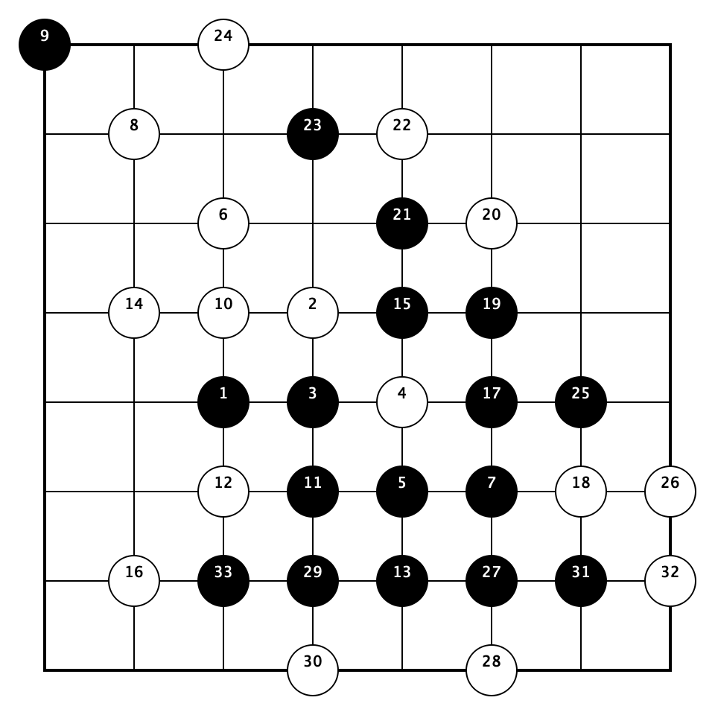
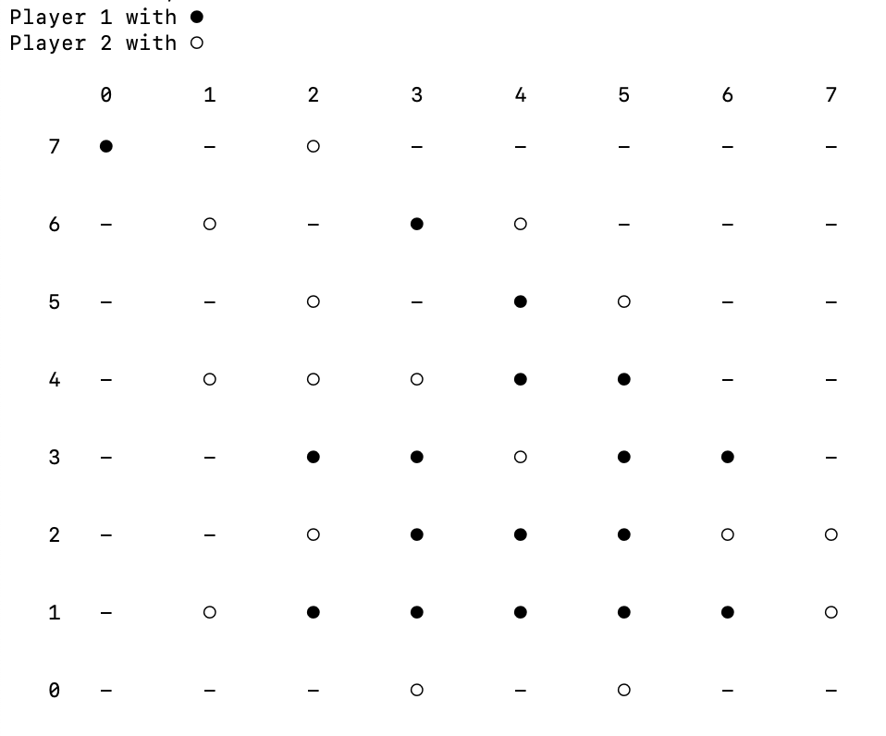
Experiments
Human wins the game

Slide 54
04
PART
Future Work

Slide 55
Future Work
We need to train a model that meets the size of 15×15. Due to the small board size, the model cannot derive more complex policies to attack and defend during training.
We need to further optimize the structure of neural network, since the larger board usually has larger action space and the state space.
We can train different models to match different rules of Gobang. By applying other more complex rules, it is possible to resolve the problem of data imbalance.

Slide 56
THANKS

